Slide 1
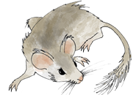

Introduction to Paleoecoinformatics & the Neotoma Paleoecology Database
Jack Williams, Jessica Blois, Simon Goring, Alison Smith, Joaquin Arroyo-Cabrales, Allan Ashworth, Julio Betancourt, Jessica Blois, Bob Booth, Phil Buckland, Don Charles, Steve Crawford, Brandon Curry, Ed Davis, Suzette Flantua, Thomas Giesecke, Graciela Gil-Romera, Steve Jackson, Jonathan Nelson, Suzie Pilaar-Birch, Rob Roth, Mike Stryker, Russ Graham, Eric Grimm, and many others
Geoinformatics,
EarthCube
Notes:
Thank you.
Acknowedge collaborators.
Talk in two parts.
First, talk about building community data networks in paleoecology – as example of larger class of activities that I call community curated database
Second, show the kind of large-scale synthetic science that is enabled with open high-quality data platforms, using PalEON as an example.

Slide 2
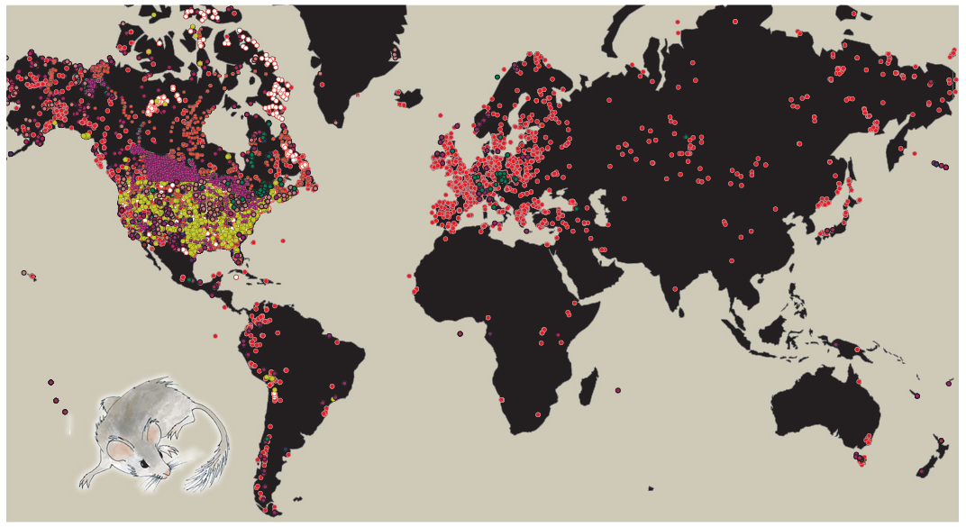
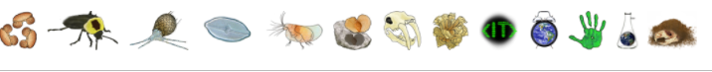
Neotoma Paleoecology Database
Mission: Support global-change research by providing an open, community-curated resource for multiple kinds of paleoecological data
Key Characteristics
Open Data
Curated by Community -> High-Value Data
Standardized Variable Names & Taxonomy
Flexible data models for sites, proxies, cores, etc.
Time: Age Controls and Age Models
>9 million observations
>42,600 datasets
>19,800 sites
(April 28, 2022)
Fossil Pollen, Vertebrates, Diatoms, Ostracodes, Testate Amoebae, Stable Isotopes, Plant Macrofossils, Packrat Middens, …
www.neotomadb.org
Williams, Grimm et al. 2018 Quaternary Research

Slide 3

Macro-scale global-change ecology now requires collaboration among at least four groups
STATISTICS
FIELD/LAB DATA
MECHANISTIC MODELS
INFORMATICS
Neotoma DB
Notes:
Not to belabor the point, but note that the data and models don’t talk to each other directly anymore.
Statistics:
Characterize uncertainty
Informatics:
Maximize data availability
Maximize research power
Maximize reproducibility

Slide 4
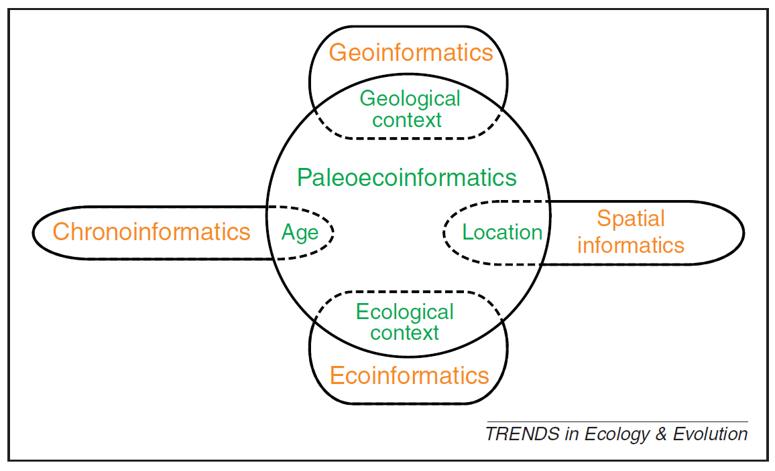
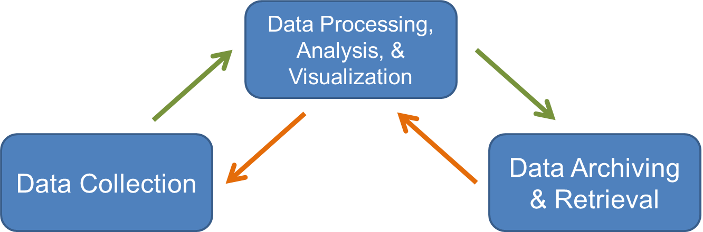
Informatics: designing systems that deliver the right information, to the right person in the right place and time, in the right way. (Wikipedia)
Paleoecoinformatics: the collection, organization, analysis, synthesis, and curation of paleoecological data
Brewer et al. 2012 TREE

Slide 5
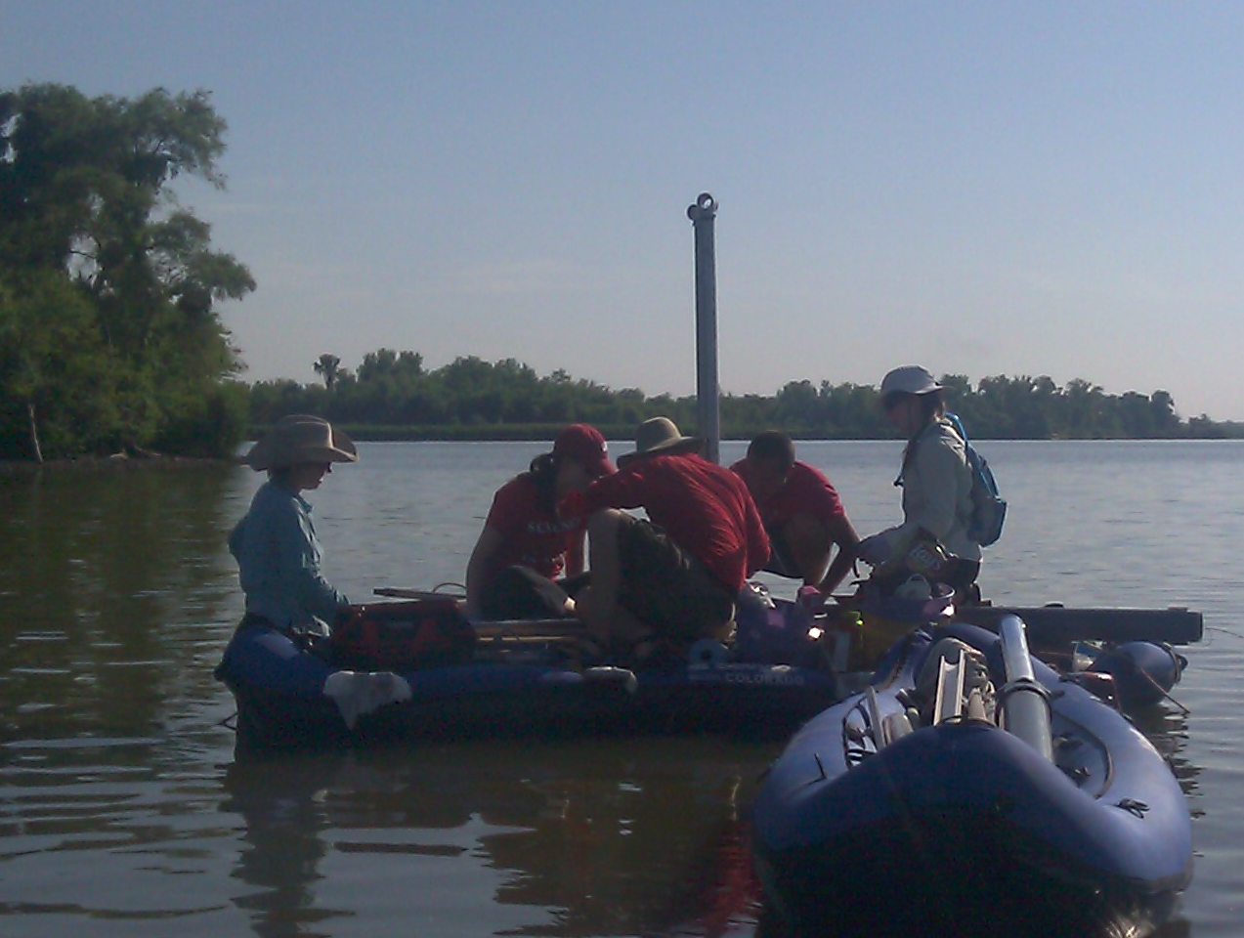
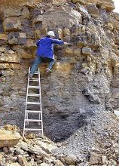
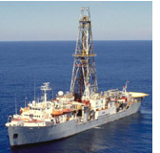
Paleodata: Key characteristics
‘Long Tail’: Collected in the field & lab by many individuals and scientific teams.
Heterogeneity: Many kinds of measurements & methods
Distributed Scientific Expertise by proxy type, archive type, region, time period, and/or taxonomic group
Commonality: All involve measurements of proxies in various geological archives by depth, from which we estimate time.
Long Shelf Life: specimens & samples collected decades ago can be re-analyzed
Bad News
Good News

Slide 6
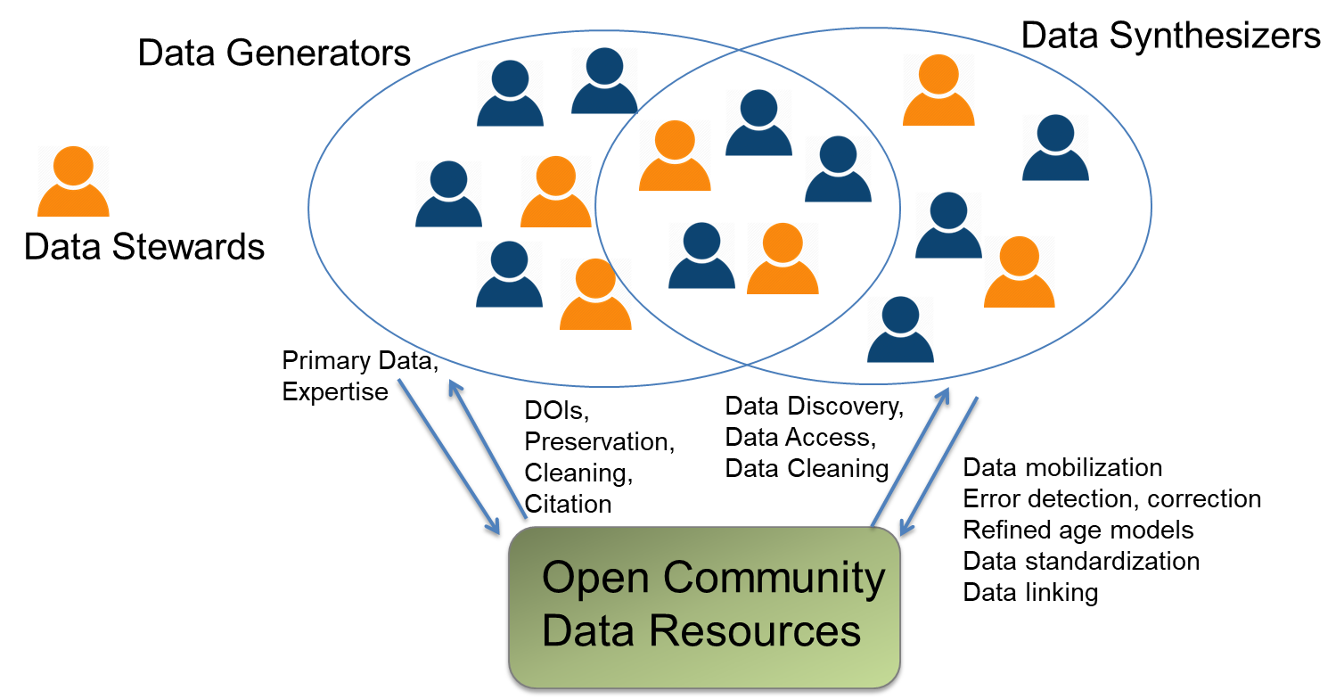
Data Governance: Community Curated Data Resources
Support and supported by overlapping communities of Data Generators, Data Synthesizers, and Data Stewards
Williams et al. 2018. PAGES Mag.
Williams, Grimm et al. 2018 QR

Slide 7
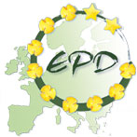
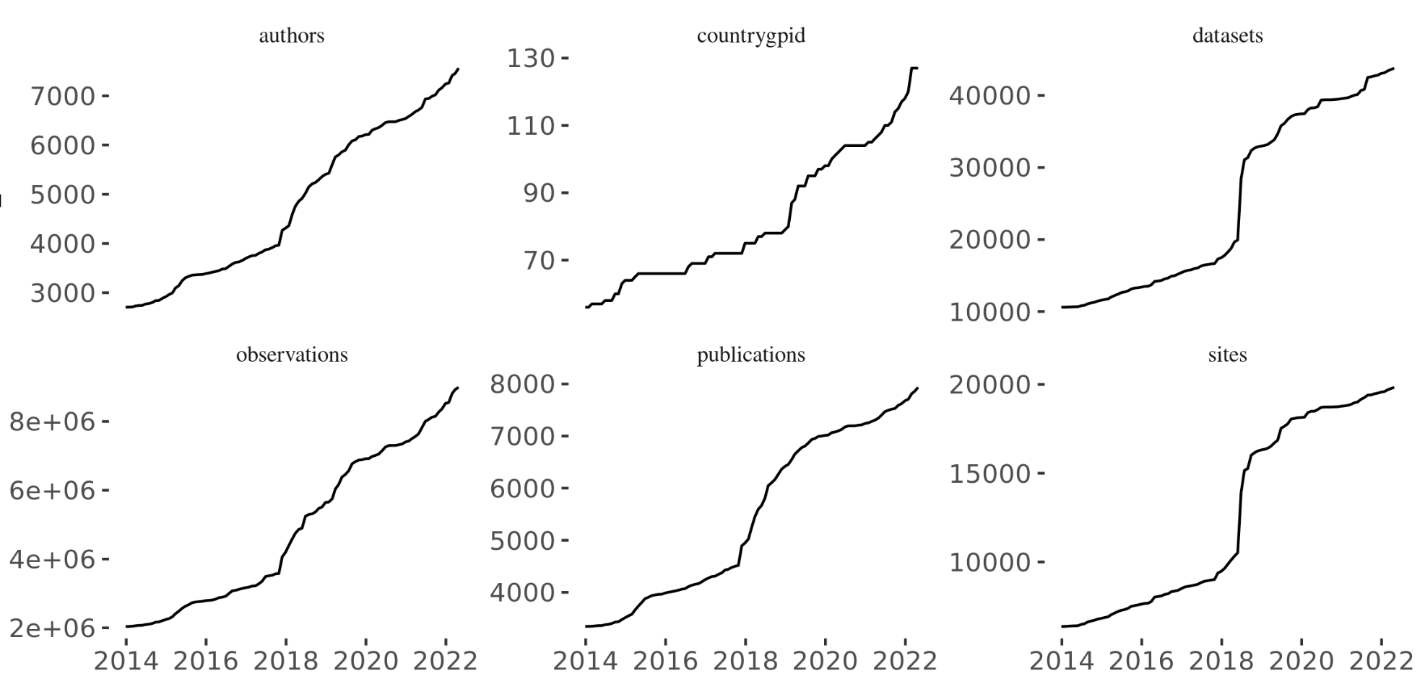
Neotoma: Data Growth
Authors
Countries
Datasets
7,568
127
42,643
Total Data Volume
Datapoints
Publications
Sites
9.01 million
7,938
19,838
Year
Plots by S. Goring. Numbers and plots as of April 28, 2022
Notes:
Accumulated total volume of Neotoma data holdings, by number of datapoints.
Data volume has roughly tripled since 2014.

Slide 8
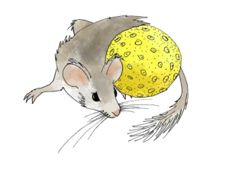
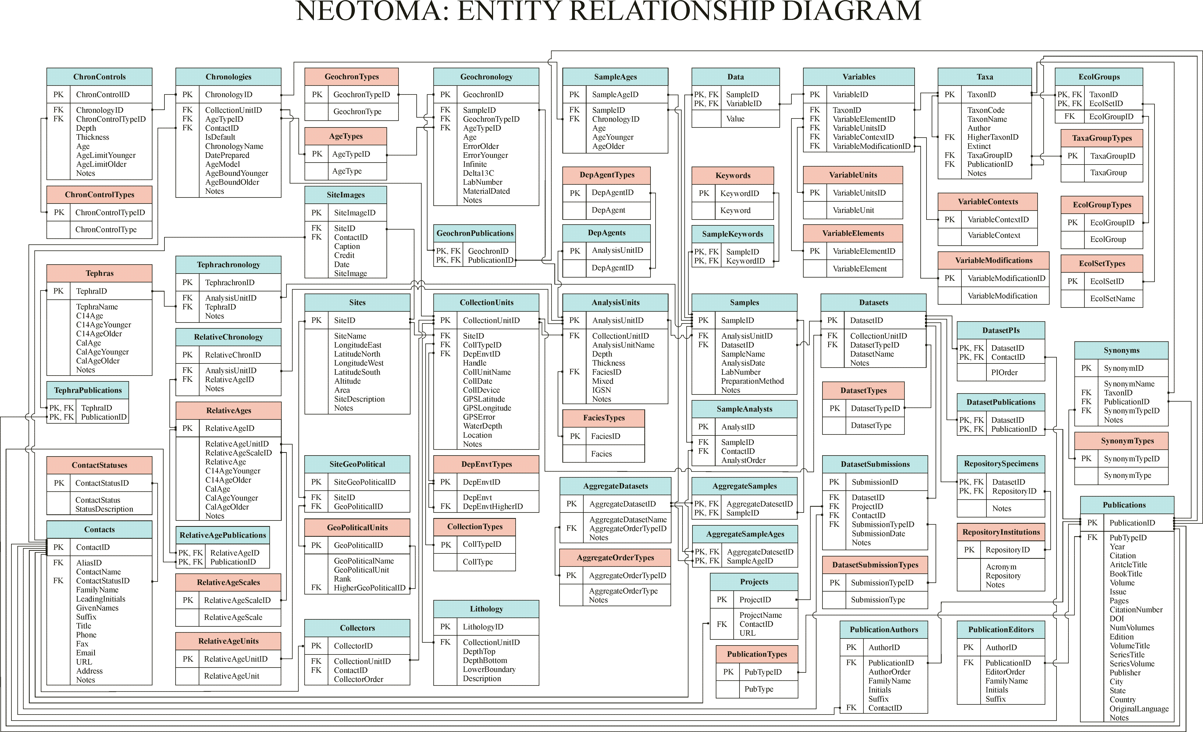
2. Key Concepts & Data Model
Database Structure
https://neotoma-manual.readthedocs.io/en/latest/

Slide 9
Key Concepts: Sites, Collection Units, Analysis Units, Samples, Datasets
Sites
CollectionUnits
AnalysisUnits
Samples
Datasets
SiteID
SiteName
LongitudeEast
LatitudeNorth
LongitudeWest
LatitudeSouth
Altitude
Area
SiteDescription
Notes
CollectionUnitID
SiteID
CollTypeID
DepEnvtID
Handle
CollUnitName
CollDate
CollDevice
GPSLatitude
GPSLongitude
GPSError
WaterDepth
Location
Notes
AnalysisUnitID
CollectionUnitID
AnalysisUnitName
Depth
Thickness
FaciesID
Mixed
IGSN
Notes
SampleID
AnalysisUnitID
DatasetID
SampleName
AnalysisDate
LabNumber
PreparationMethod
Notes
DatasetID
CollectionUnitID
DatasetTypeID
DatasetName
Notes
One site may have many collection units
One collection unit may have many analysis units
One analysis unit may have many samples
A dataset comprises all samples of same type from same collection unit

Slide 10
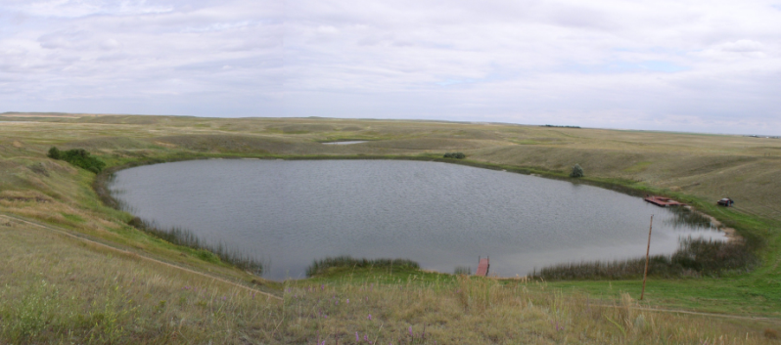
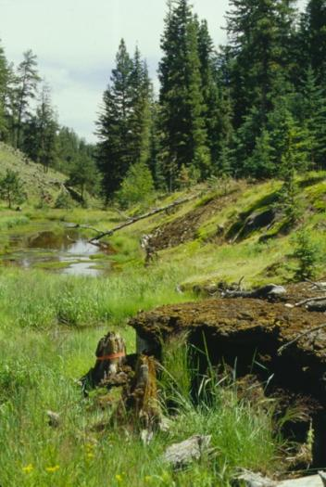
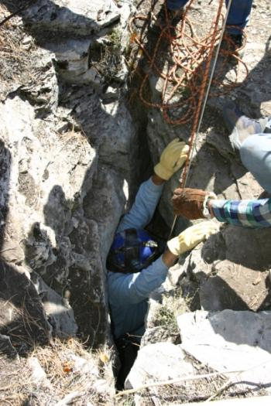
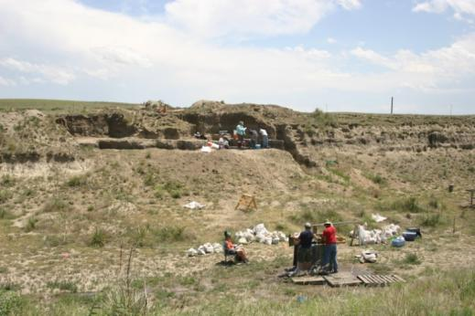
Sites
Sites Table
Lakes
SiteID
SiteName
LongitudeEast
LatitudeNorth
LongitudeWest
LatitudeSouth
Altitude
Area
SiteDescription
Notes
Sections
Caves
Archaeological Digs

Slide 11
Collection Units
Sites
CollectionUnits
Examples
Multiple cores w/in a lake
Multiple pits w/in an archaeological dig
Multiple bone piles within a cave
etc.
SiteID
SiteName
LongitudeEast
LatitudeNorth
LongitudeWest
LatitudeSouth
Altitude
Area
SiteDescription
Notes
CollectionUnitID
SiteID
CollTypeID
DepEnvtID
Handle
CollUnitName
CollDate
CollDevice
GPSLatitude
GPSLongitude
GPSError
WaterDepth
Location
Notes

Slide 12
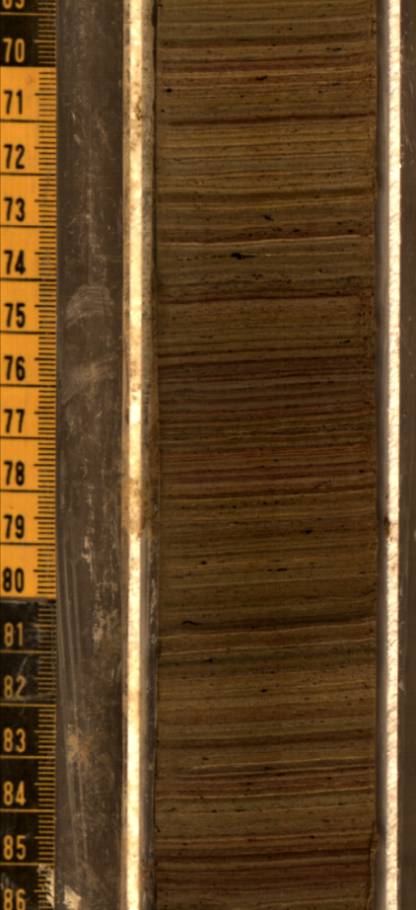
Analysis Units
CollectionUnits
AnalysisUnits
CollectionUnitID
SiteID
CollTypeID
DepEnvtID
Handle
CollUnitName
CollDate
CollDevice
GPSLatitude
GPSLongitude
GPSError
WaterDepth
Location
Notes
AnalysisUnitID
CollectionUnitID
AnalysisUnitName
Depth
Thickness
FaciesID
Mixed
IGSN
Notes
Analysis units have a depth and thickness
Example: depths within a sediment core

Slide 13
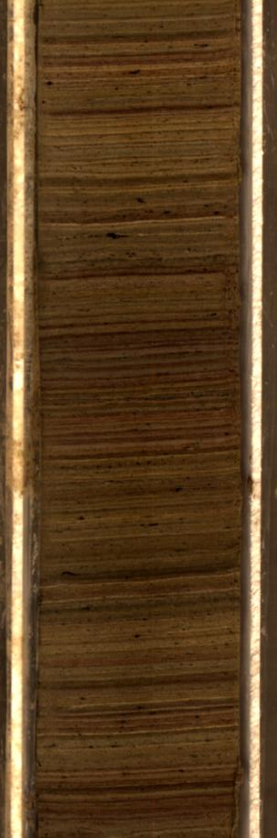
Samples
AnalysisUnits
Samples
AnalysisUnitID
CollectionUnitID
AnalysisUnitName
Depth
Thickness
FaciesID
Mixed
IGSN
Notes
SampleID
AnalysisUnitID
DatasetID
SampleName
AnalysisDate
LabNumber
PreparationMethod
Notes
Pollen
Charcoal
Diatoms
Loss-on-ignition
Example: pollen, charcoal, diatom samples from a single depth interval in a core

Slide 14
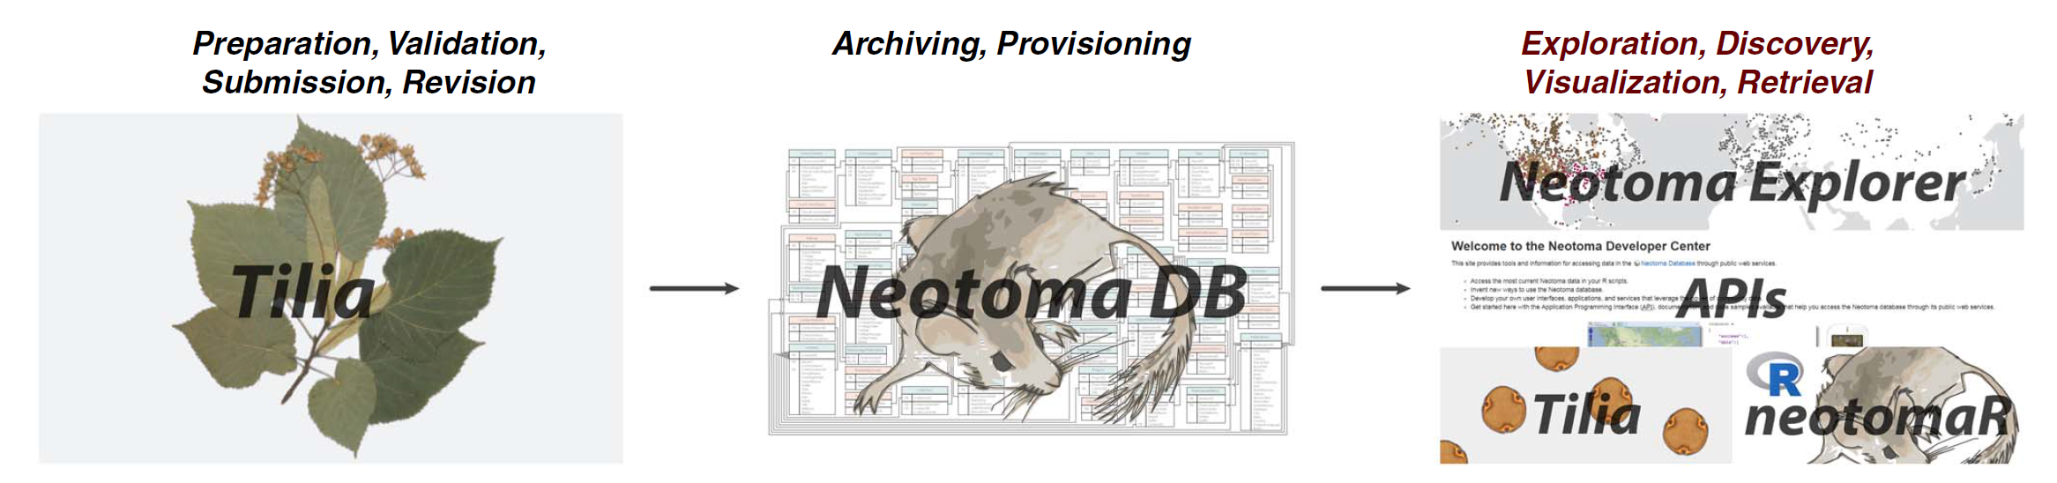
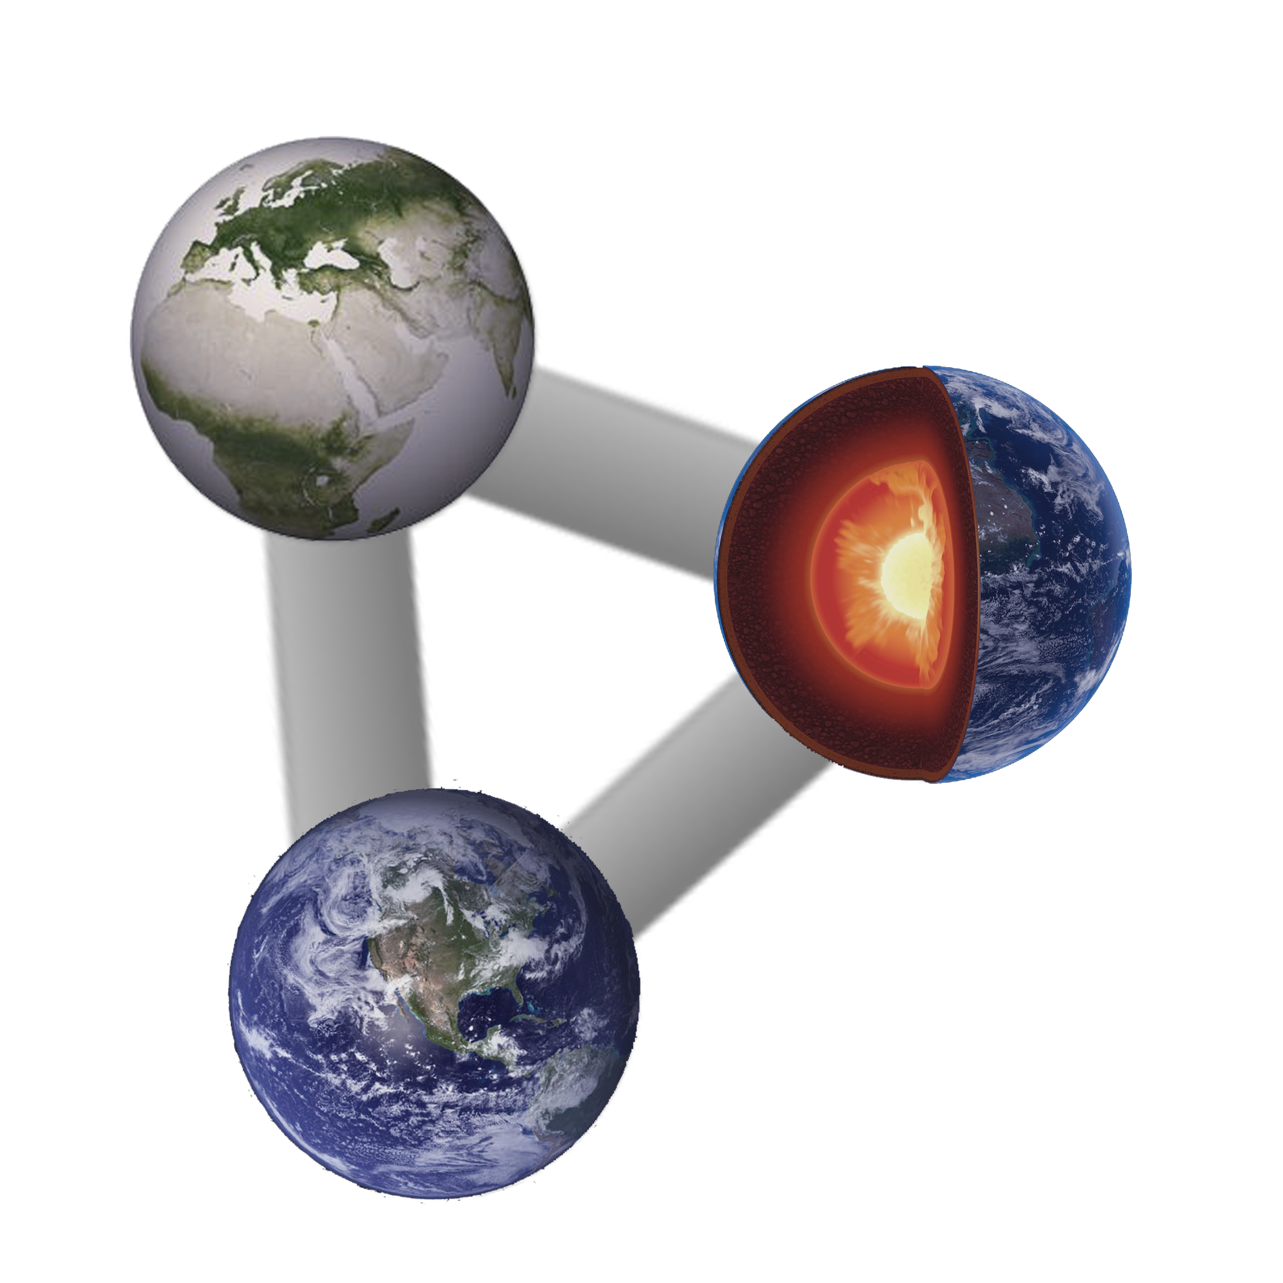

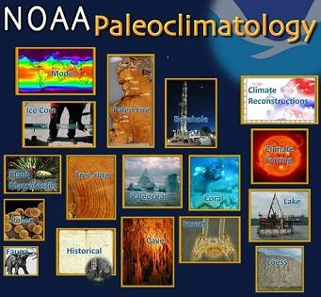
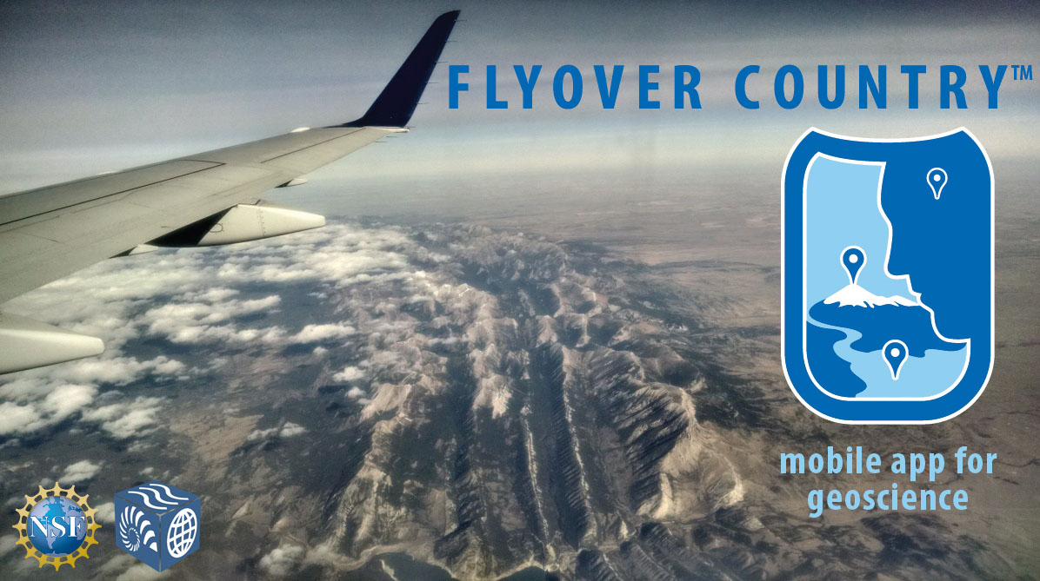
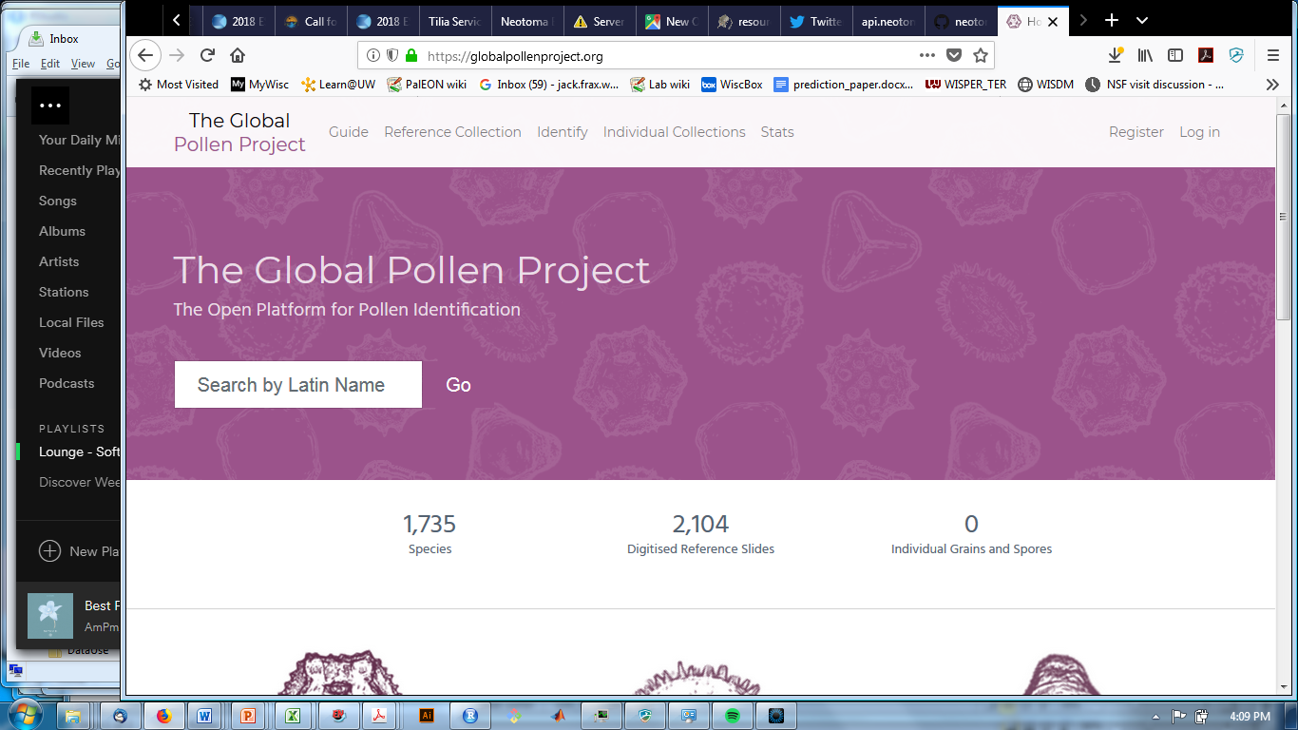
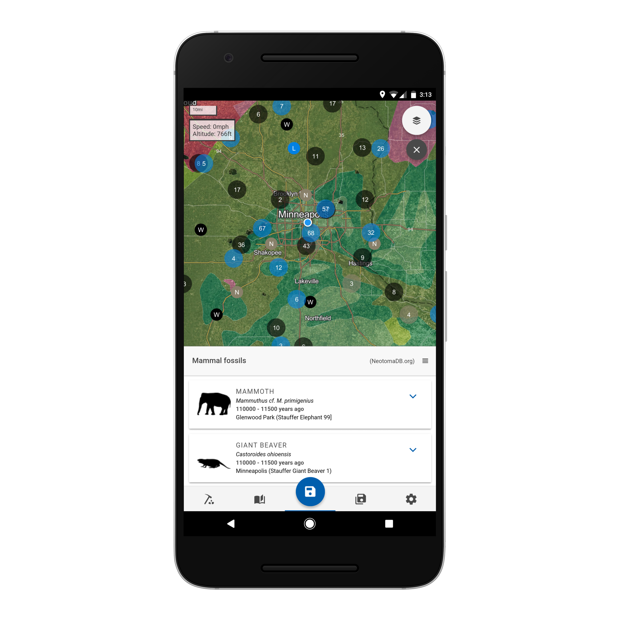
Neotoma: Software Stack
APIs
/data/
sites
/data/
occurrences
/data/
contacts
[etc.]
Neotoma Services
Linked Earth
Third-Party Services

Slide 15
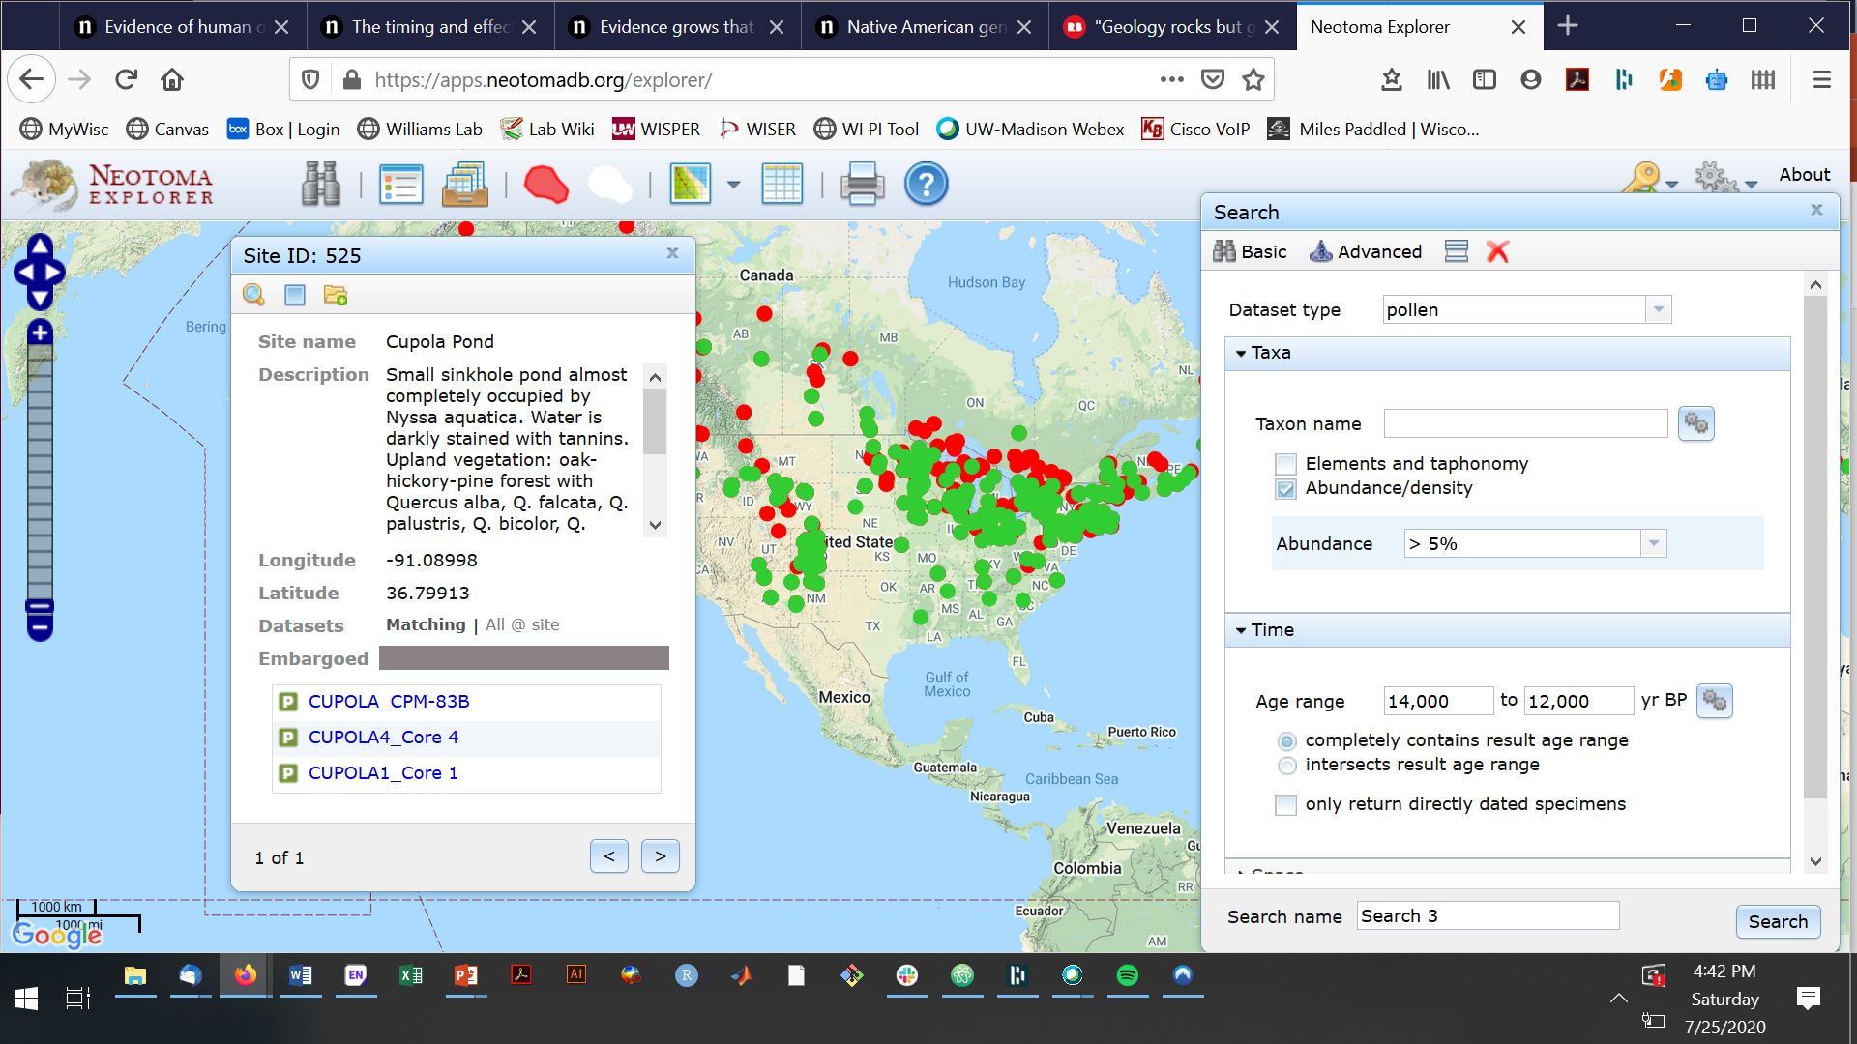
Software Ecosystem: Explorer Quick-look data views
https://apps.neotomadb.org/explorer/

Slide 16
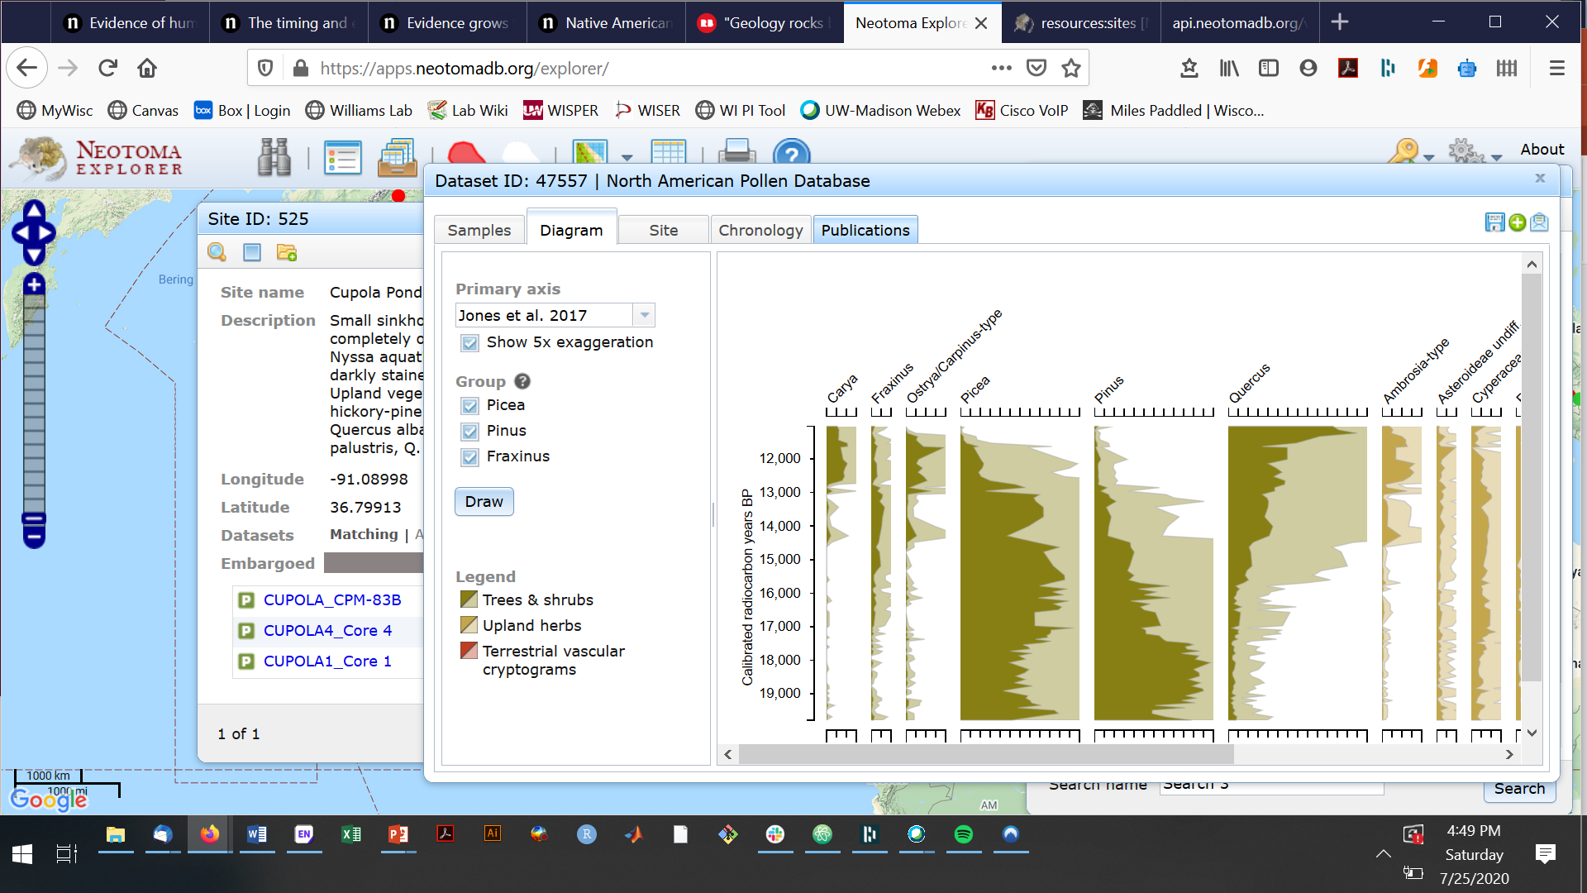
Software Ecosystem: Explorer Quick-look data views
https://apps.neotomadb.org/explorer/

Slide 17
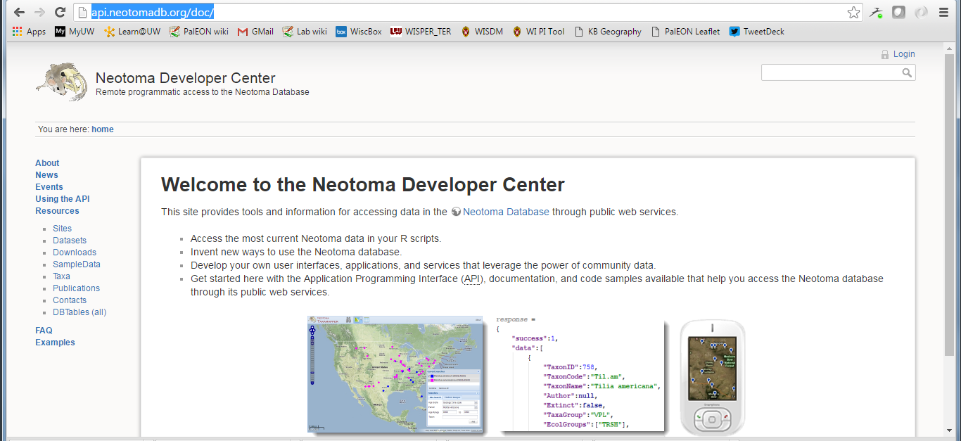
Software Ecosystem: APIs Programmatic access
Example:
http://api.neotomadb.org/v1/data/sites?loc=-92.9,46.3,-77.3,55.2
APIs & Documentation:
https://api.neotomadb.org/doc/

Slide 18
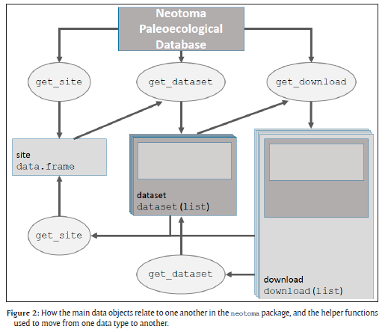
Software Ecosystem: R neotoma Scientific Scripting Access
Key Functions
get_site
get_dataset
get_download
get_chroncontrol
get_table
get_taxa
Other Functions
get_closest
get_contact
get_publication
Package: https://cran.r-project.org/
GitHub Repository: https://github.com/NeotomaDB/neotoma

Slide 19
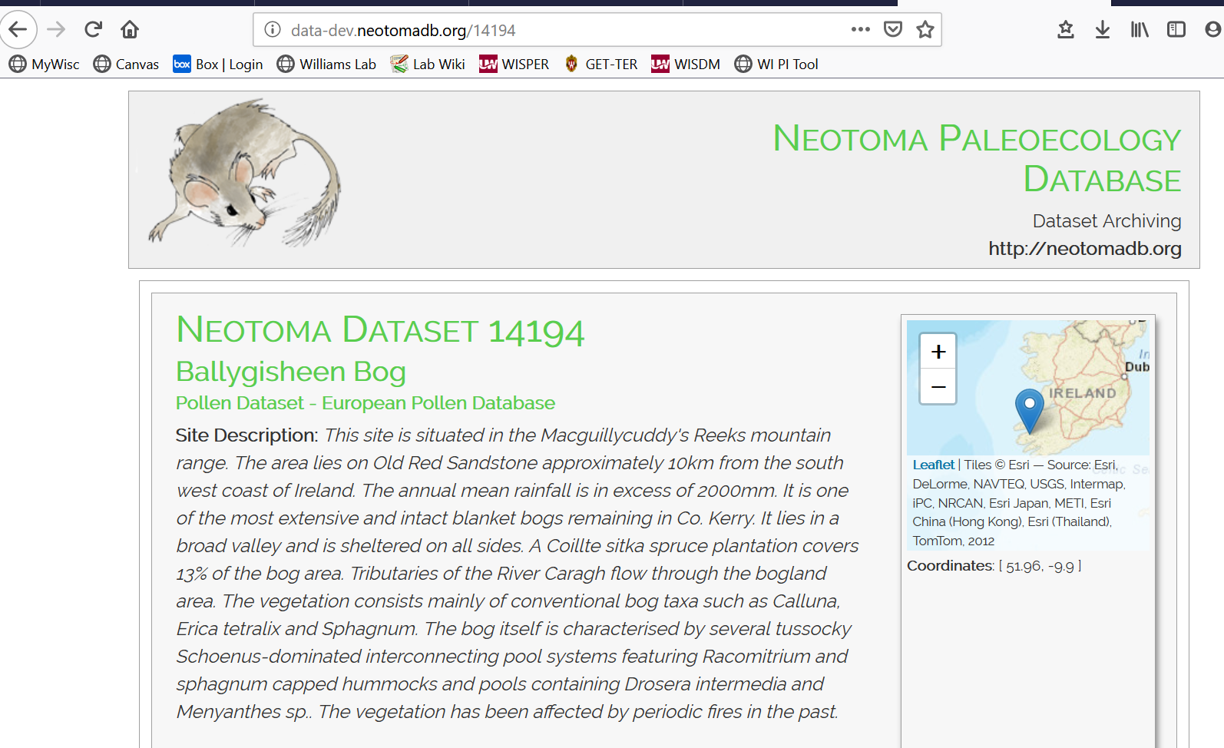
Software Ecosystem: DOIs, Landing Pages Data archival & discovery
Sample landing page.
Two versions of dataset stored: 1) at time of upload & 2) current living version
http://data-dev.neotomadb.org/14194
DOI Design: S. Goring

Slide 20
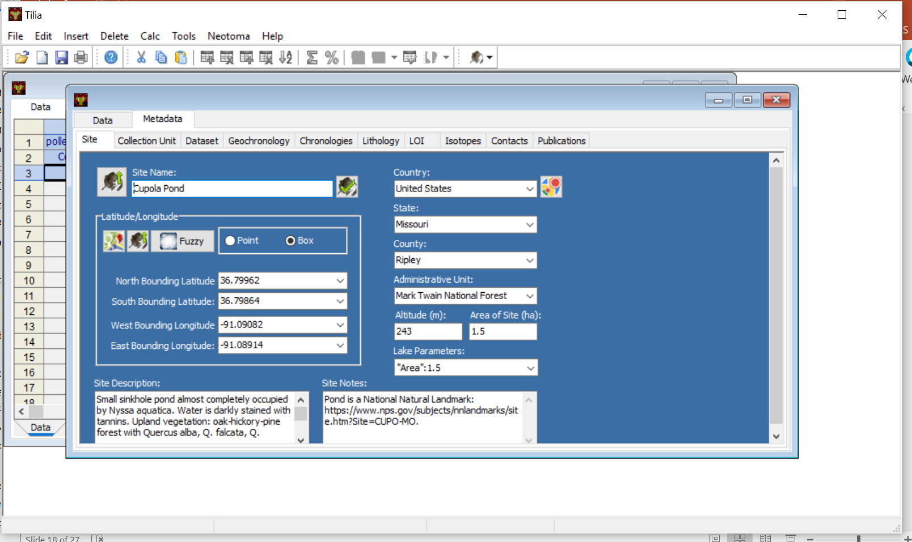
Software Ecosystem: Tilia Data Uploads, QA/QC, Curation
Download: http://www.tiliait.com/download/

Slide 21


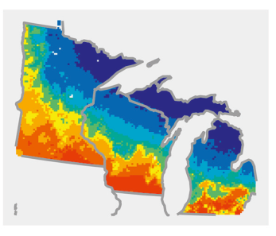

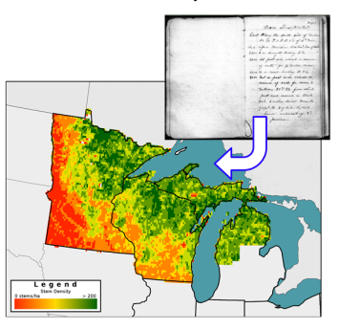
Leveraging Neotoma for new research syntheses: PalEON example
Data cleaning,
standardization,
upload
Individual Data Contributors
Hotchkiss, Calcote, & Lynch
Hupy & Yansa
Booth & Jackson
Cushing
St. Jacques
Neotoma DB
R
neotoma
Rebuild age
models (bacon)
STEPPS
Pollen
Paleoveg.
Witness Tree
Data
Reconstrux
w/ uncertainty
Vegetation
Goring et al. (2015) Open Quaternary
Goring et al. (in press) PLoS One
Dawson et al. (2016) QSR

Slide 22
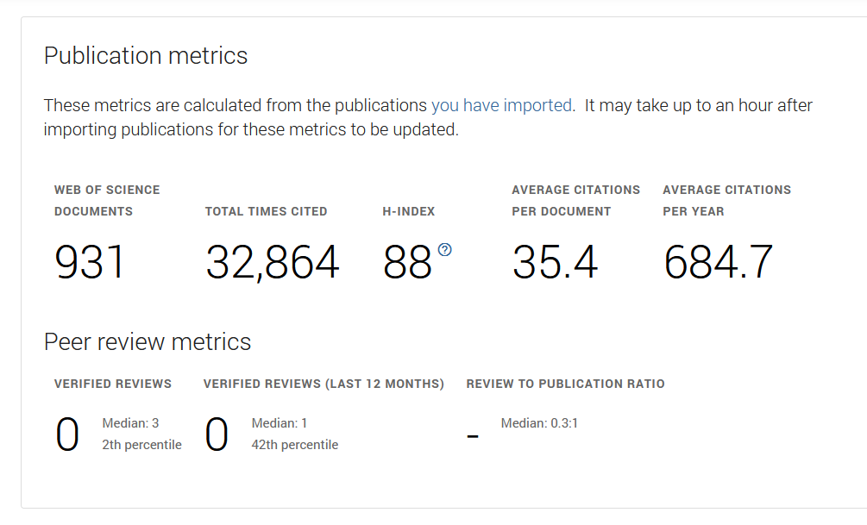
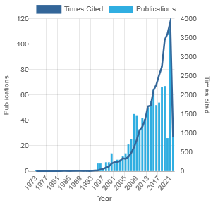
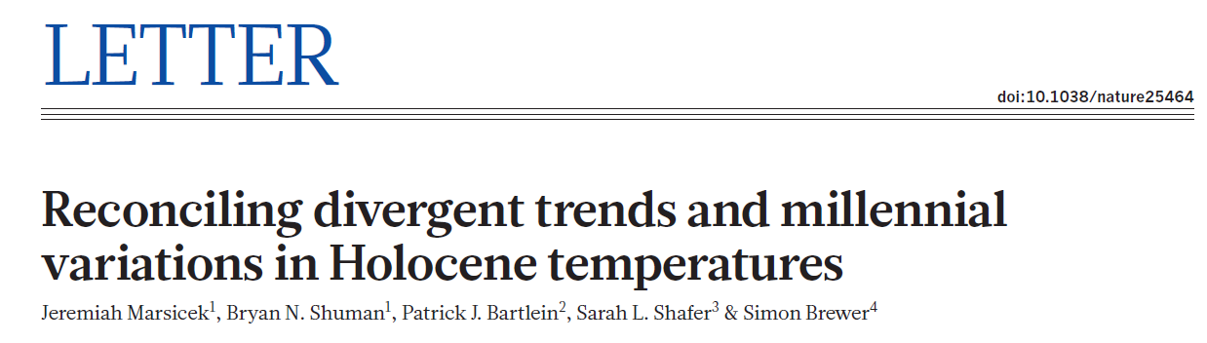
Neotoma: Supporting Science
Marsicek et al. 2018 Nature
Source: Publons
Last updated: Oct 11, 2021
Kaufman et al. 2018 Nat. Sci. Data
Notes:
Accumulated total volume of Neotoma data holdings, by number of datapoints.
Data volume has roughly tripled since 2014.

Slide 23
More Resources
GitHub - Neotoma
https://github.com/NeotomaDB
Slack Channel for Data Stewards
https://neotomadb.slack.com
Neotoma Database Schema
http://open.neotomadb.org/dbschema/
Neotoma Manual, Design Concepts, etc.
http://neotoma-manual.readthedocs.io/en/latest/index.html
Global Pollen Project [third party]
https://globalpollenproject.org/
Full List of Neotoma Resources
https://www.neotomadb.org/about/category/resources

Slide 24

Summary:
Mission: Support global-change research by providing an open, community-curated resource for multiple kinds of paleoecological data
Governance: Open membership, Constituent Databases each govern different datasets
Software Ecosystem:
Explorer: Quick-look data views
APIs: Programmatic access
R neotoma: Scientific Scripting Access
DOIs, Landing Pages: Data archival & discovery
Tilia: Data Uploads, QA/QC, Curation
More Info:
www.neotomadb.org
neotoma-contact@googlegroups.com
@neotomadb
Williams, Grimm et al. 2018 Quat Res
Notes:
Key Concepts
Members
Data Stewards
Constituent Databases
Leadership Council

Slide 26
Neotoma: Software Ecosystem

Slide 27
Software Ecosystem: Overview
NOAA/WDC-Paleo
Earth-Life
Consortium
Global Pollen
Project
Flyover Country

